Slide 1
Dataset

Slide 2
Dataset
Scraped using Tweepy API for the purpose of working on the idea of tracking Mental Health from Social Media.
Labeled based on expert studies in the mental health domain.
Contained from 4 features: stress, lonely, anxiety, and normal.
Found as cleaned dataset on: https://www.kaggle.com/datasets/arshkandroo/behavioural-tweets, but after contacting “Arsh Kandroo”, he sent me the dataset before cleaning.

Slide 3
Use case

Slide 4
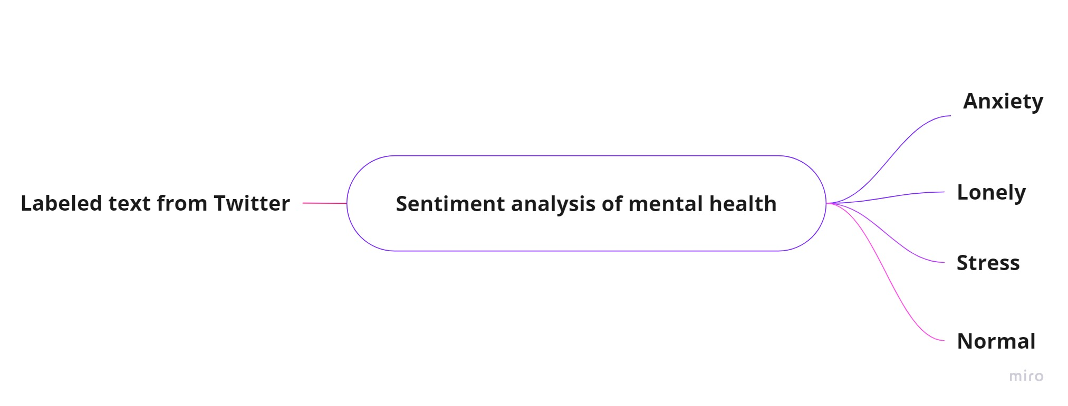
Use case
Classify the input text into its class from the 4 classes we have to know the sentiment of the input.

Slide 5
Data Exploration

Slide 6
Data Exploration
Visualize the percentage of each class in the dataset using pie chart
Visualize the distribution of the classes vs the frequency of them
Visualize the most important words in each class using Word Cloud library
Visualize the top countries that have mental health problems
Visualize the days of the week to show when people suffer from mental health problems.

Slide 7
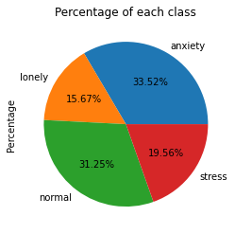
Data Exploration
The percentage of each class

Slide 8
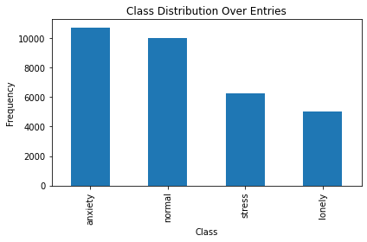
Data Exploration
The distribution of the classes

Slide 9
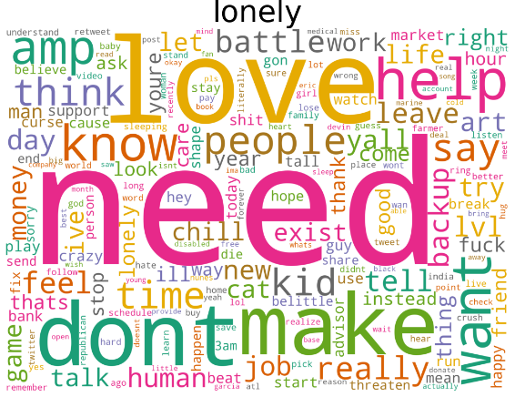
Data Exploration
The most important words in the lonely class

Slide 10
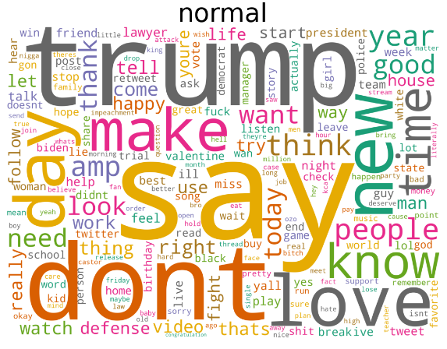
Data Exploration
The most important words in the normal class

Slide 11
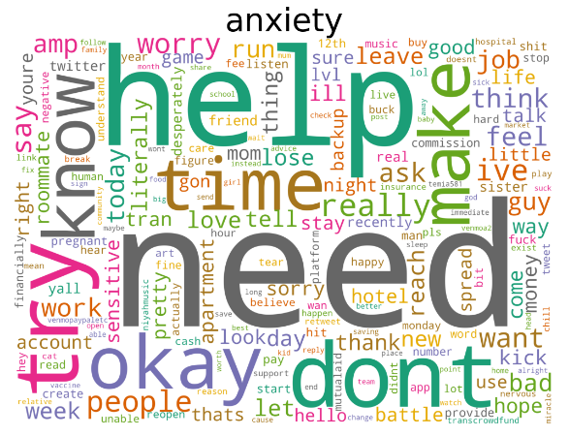
Data Exploration
The most important words in the anxiety class

Slide 12
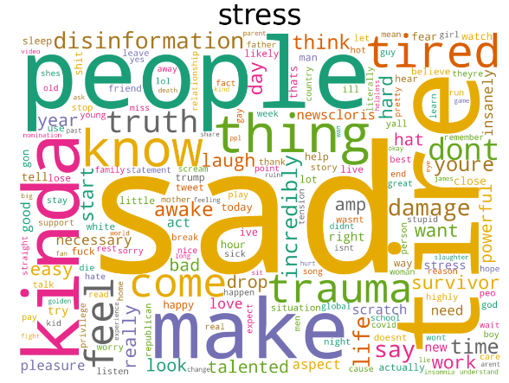
Data Exploration
The most important words in the stress class

Slide 13
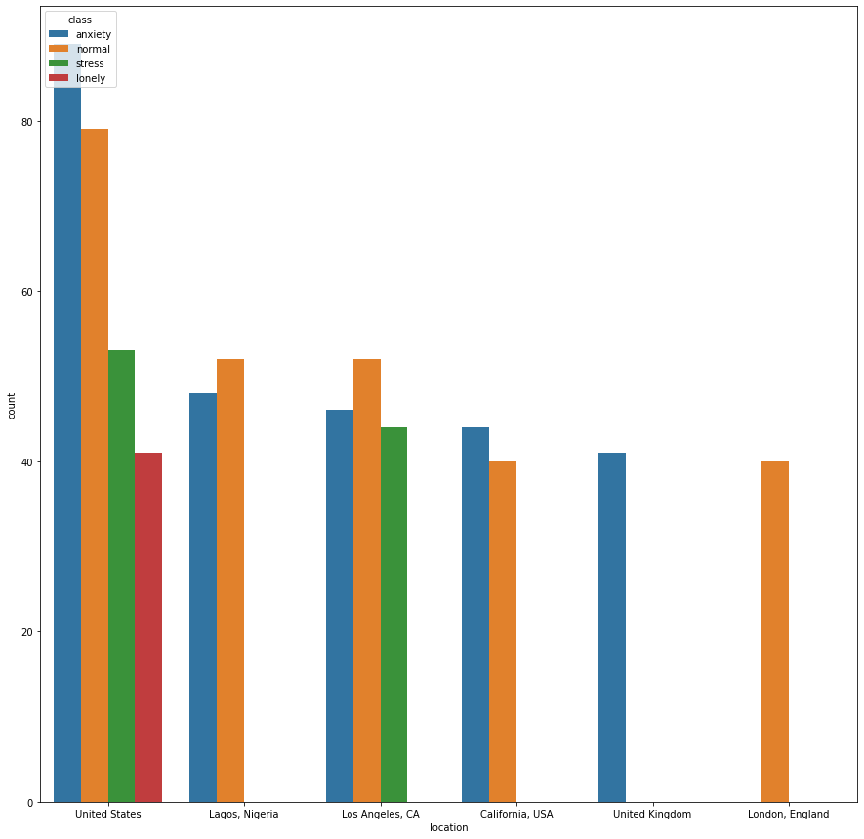
Data Exploration
The top countries that
have mental health problems

Slide 14
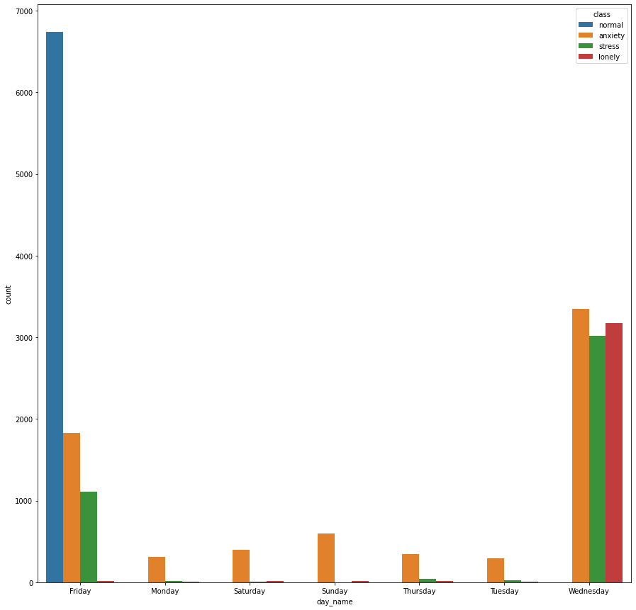
Data Exploration
Days of the week that people suffer
from mental health problems

Slide 15
Data Preprocessing

Slide 16
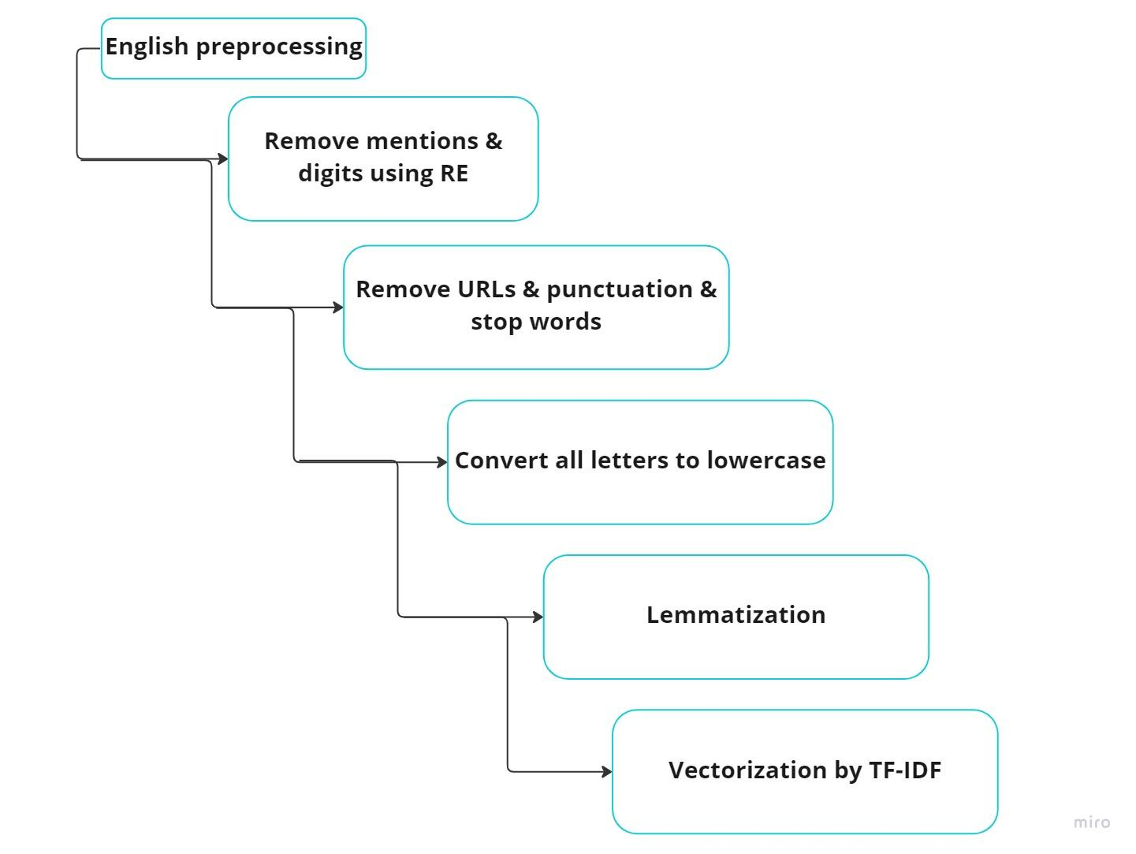
Data Preprocessing

Slide 17
Data Modelling

Slide 18
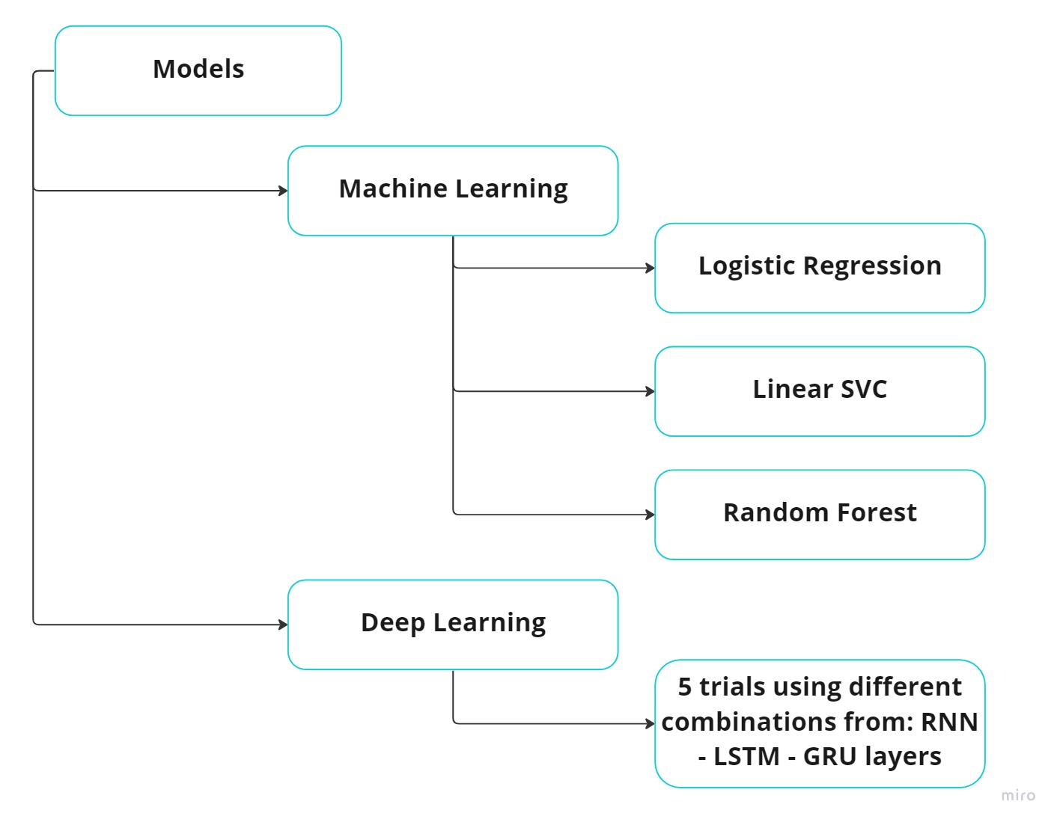
Data Modeling

Slide 19
Results

Slide 20
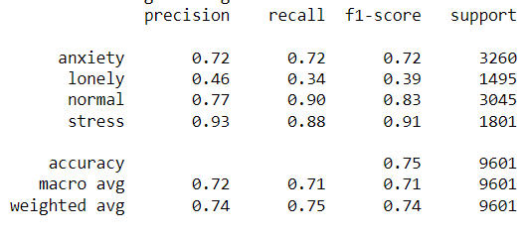
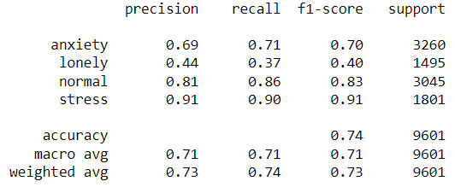
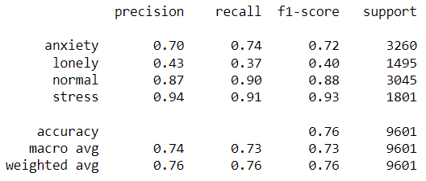
Results (Machine Learning)
Logistic Regression
Linear SVC
Random Forest
Accuracy: 74.98%
Classification report:
Accuracy: 73.81%
Classification report:
Accuracy: 76.29%
Classification report:

Slide 21
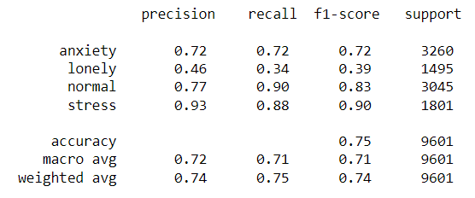
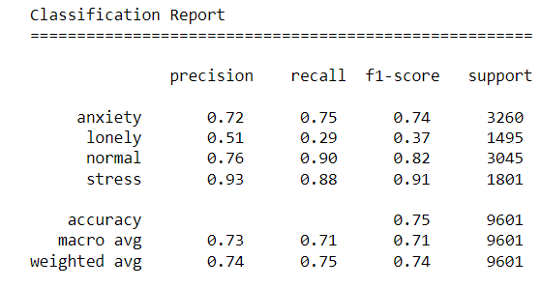
Results (ML - tuning)
In the logistic regression: tune the C value, and the solver using Gridsearch method.
Accuracy: 74.89%
Classification report:
In the linear SVC: tune the C value using Gridsearch method.
Accuracy: 75.29%
Classification report:

Slide 22
Results (Deep Learning)
First trial using: 1 LSTM layer with training the model on batch size = 64
Accuracy: 76.1%, Loss: 0.686
Second trial using: 2 LSTM layers with training the model on batch size = 64
Accuracy: 74.4%, Loss: 1.150
Third trial using: 1 GRU layer with training the model on batch size = 64
Accuracy: 74.9%, Loss: 1.124
Fourth trial using: 2 GRU layers with training the model on batch size = 64
Accuracy: 73.5%, Loss: 1.314
Fifth trial using: 1 GRU layer, 1 LSTM layer with training the model on batch size = 64
Accuracy: 74.4%, Loss: 1.331

Slide 23
Findings

Slide 24
Findings
Data exploration helps in understanding the dataset more.
Cleaning the text helps in reducing the dimensionality of the features, and helps in getting better performance with the machine learning models and the deep learning models.
Tuning the hyperparameters helps the models to achieve better results.
In my case training the model on batch size = 64 gave better results than training the model on batch size = 128

Slide 25
Thank you

